Slide 1
Small Molecules: Application in Tissue Engineering
Presenters: Mahroo Hajimehdi, Nafiseh Pakdin, Mahya Sharifi, Fateme Ardehali
Supervisor: Dr. Bakhshandeh
Department of Biology, University of Tehran
Fall 2021

Slide 2
CONTENTS
01
02
03
04
Introduction
Mechanism
Application
References
What are Small Molecules?
Why are they important?
How do they effect their target
What aspects are of interest?
Where is it used?
What are the effects?

Slide 3
01
Introduction
What are Small Molecules?
Why are they important?

Slide 4
Small molecules are molecules with a molecular weight of < 1000 Da.
They are reproducibly synthesized through chemical reactions or extracted from organisms including plants.

Slide 5
EXAMPLES
Pharmaceutical Drugs
insulin, aspirin,
antihistamines
Biological Molecules
fatty acids, glucose,
amino acids, cholesterol
Secondary Metabolites
glycosides, alkaloids,
natural phenols
Do NOT Include
polysaccharides, proteins, nucleic acids

Slide 6
Small molecules
Biologics

Slide 7
 | Small Molecules | Biologics
Size | < 1 kDa | > 1 kDa
Stability | Chemically and thermally stable | Sensitive to heat, easily degraded
Polarity | Wide range | Polar
Cell Permeability | Extra & intracellular components, CNS | Extracellular
Delivery | Oral | Invasive
Drug-Drug Interaction | Prone | Less prone
Selectivity | Low | High
Prize | Low | High

Slide 8
A DISADVANTAGE
Small molecules use is limited by their nonspecific adverse effects on nontarget tissues and organs.
The key to success with utilizing small molecules is designing suitable delivery systems to localize and sustain the controlled release of small molecules to target sites.

Slide 9
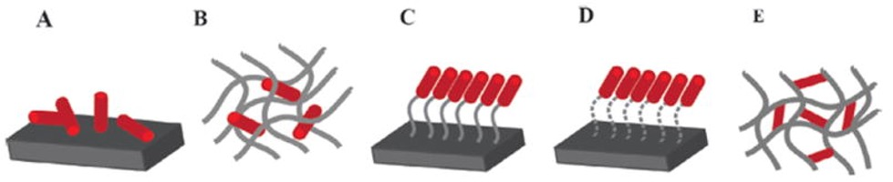
Entrapment
Entrapment
There are several types of incorporation technique. Each method has inherent advantageous depending on:
The biomolecule chemical structure
Intended scaffold fabrication method
Desired drug release profile
Covalent Binding
Covalent Binding
Adsorption
Adsorption
Crosslinking
Crosslinking

Slide 10
Mechanism
02
How do they effect their target
What aspects are of interest?

Slide 11

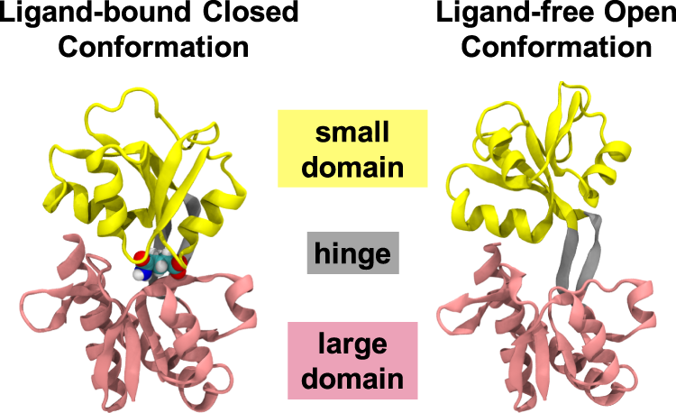
Small molecules can regulate the function of proteins as they bind to proteins to form protein–ligand complexes and induce conformational changes of the proteins at the same time.

Slide 12
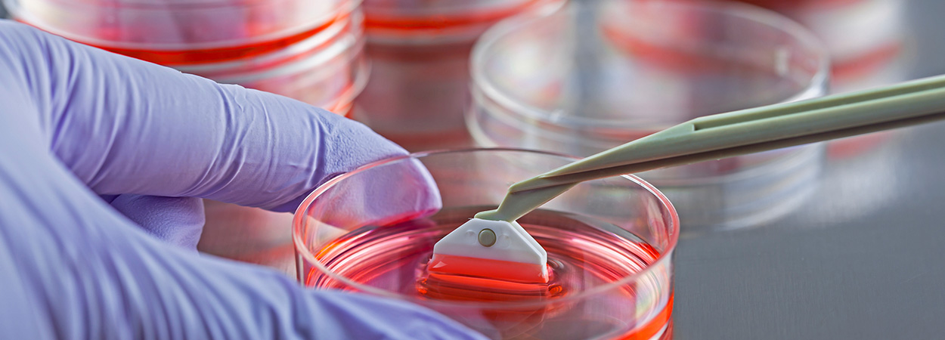
Small molecules can also induce differentiation. In tissue engineering, the regenerative properties demonstrated by some small molecules have shown promise in retaining the functional and physical traits of natural tissues.

Slide 13
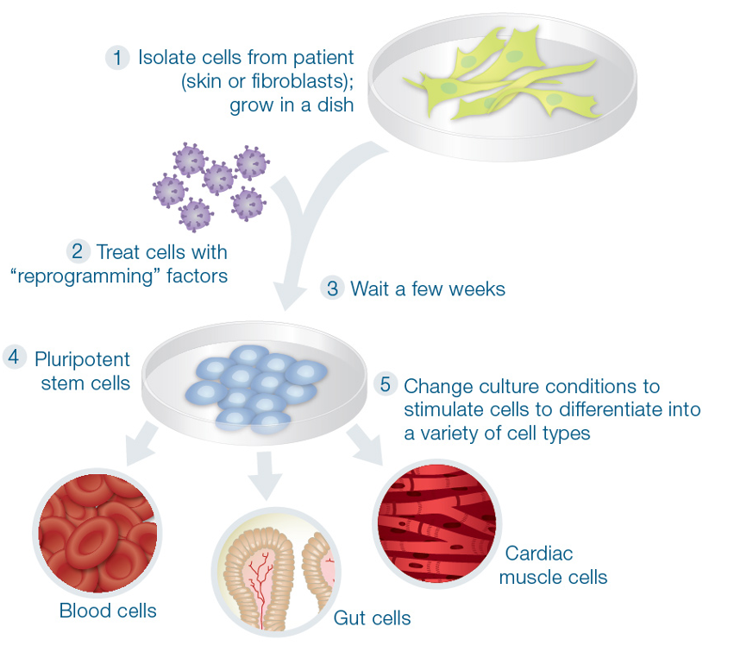
Small molecules have been used to generate iPSCs by acting as substitutes for genetic reprogramming factors.

Slide 14
The Small molecule compounds used in reprogramming protocols can be categorized into:
01
Epigenetic Modulators
03
Other factors that induce the characteristics of the designed cell type
Metabolic regulators
Signaling pathways regulators (inhibitor/activator)
04
02

Slide 15
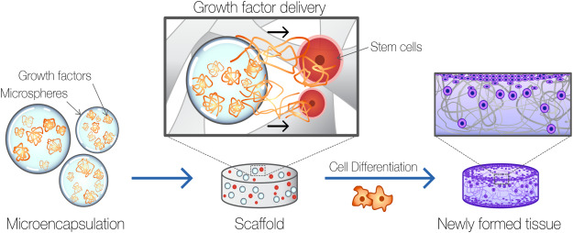
Growth factors are routinely used in the tissue engineering approach to expedite the process of regeneration. GFs can upregulate or down-regulate cellular activities (adhesion, proliferation and differentiation)
Growth Factor

Slide 16
Only few studies proceeded to clinical trials
Low half-life
Instability
High cost
Possible negative long term side effects
Limited in certain scaffold-based applications requiring thermal processing, sterilization or prolonged exposure to solvents
Growth Factors
Easier to manufacture or are available from bioresources
Less costly
Less prone to denaturation bioactivity does not depend on their higher order structure
Unlikely to induce an immune response in the host easier cellular penetration
Small Molecules

Slide 17
03
Application
Where is it used?
What are the effects?

Slide 18




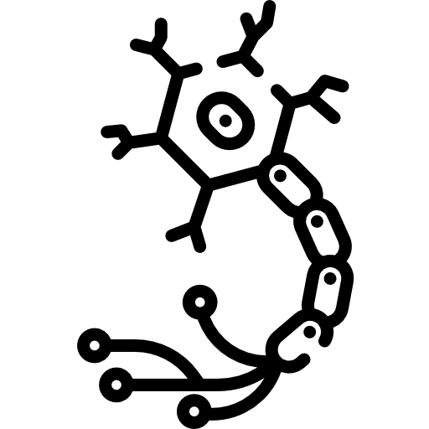
Small molecule mediated bone formation
Small molecule mediated angiogenesis
Small molecule mediated cartilage formation
Small molecule mediated muscle regeneration
Small molecule mediated neural regeneration

Slide 19
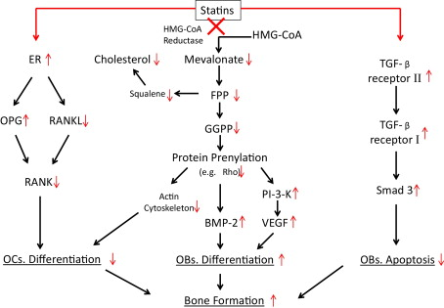
Bone Formation
Simvastatin
BMP
Simvastatin primarily used for the management of hyper-cholesterolaemia, is a promising scaffold additive in bone regeneration.
In its cholesterol lowering activity, it inhibits the enzyme HMG-CoA reductase by binding to it.
In its bone regeneration activity, the same chemical moiety inhibit the formation and activity of osteoclast.

Slide 20
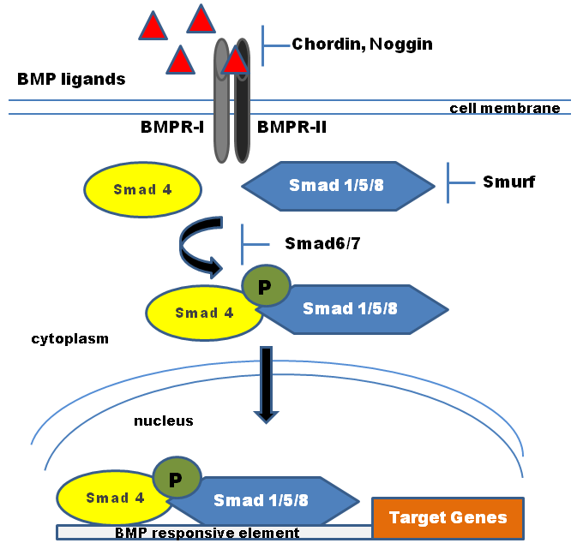
Bone Formation
SVAK-12
BMP
SVAK-12 was identified as a novel BMP signaling activator for potentiating BMP-2 induced trans-differentiation of muscle cells into osteogenic lineages by interrupting the function of Smurf1.
A single-dose of SVAK-12 (100, 250, or 500 μg) combined with a low-dose of exogenous BMP-2 (1.5 μg) enhanced ectopic bone formation when both therapeutics were subcutaneously implanted in rats.
.
Notes:
Trans-differentiation, also known as lineage reprogramming, is the process in which one mature somatic cell is transformed into another mature somatic cell without undergoing an intermediate pluripotent state or progenitor cell type

Slide 21
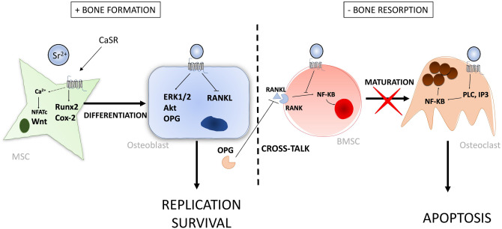
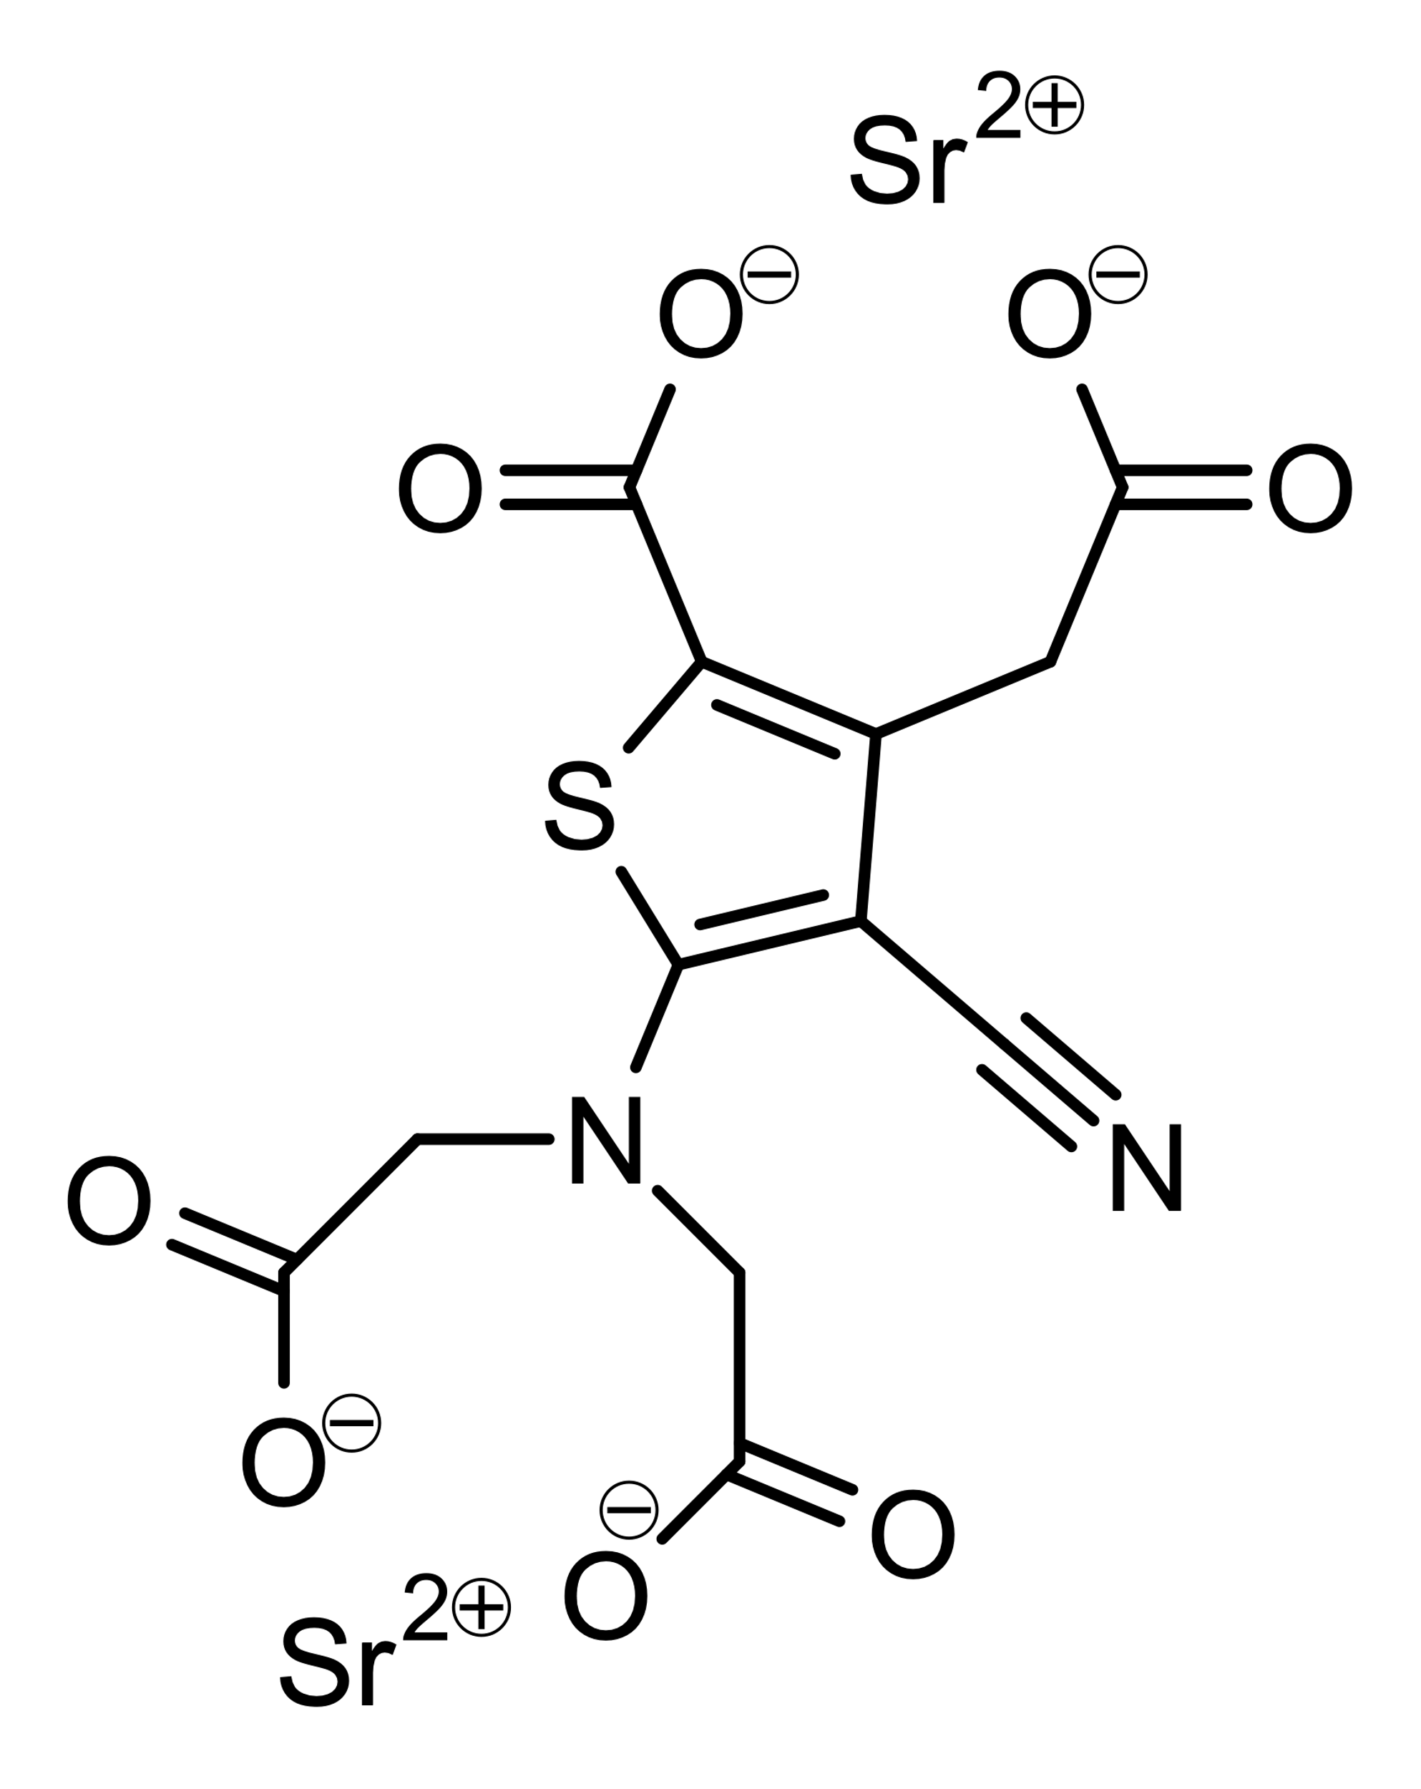
Cartilage Formation
Strontium ranelate
Is a strontium (II) salt of ranelic acid which acts as an antiosteoporotic agent which both increases bone formation and inhibits bone resorption.
Sr treatment upregulates osteogenic gene expression in osteoblasts, which has been found to be dependent on mitogen-activated protein kinase (MAPK) signalling and ERK 1/2 phosphorylation.
Sr treatment has been shown to decrease osteo-clastogenesis and therefore reduce the number of mature osteoclasts in vitro, which is directly related to a reduction in the formation of resorption pits.

Slide 22
Neural Regeneration
db-cAMP
Dibutyryl cyclic-AMP (db-cAMP) has a significant effect on neural regeneration.
Exogenous administration of db-cAMP into the injured area significantly improved motor recovery in a rat ischemia model. The db-cAMP treated rat groups showed increased expression of growth associated protein 43 (GAP-43), a protein associated with axon regeneration and neural regeneration.
Treatment with db-cAMP effectively induces neuronal differentiation of neural stem/progenitor cells (NSPCs), resulting in increase of cells expressing beta III tubulin, a neural precursor protein.

Slide 23
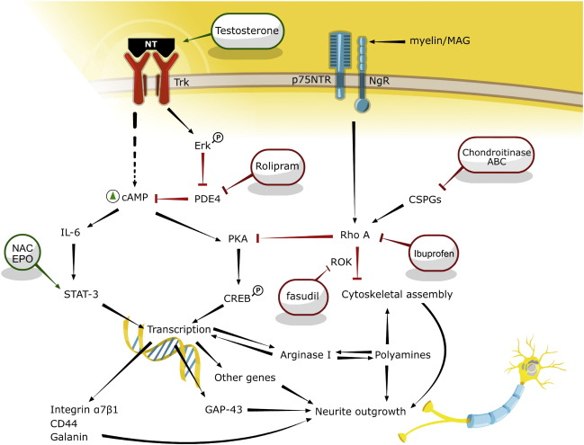
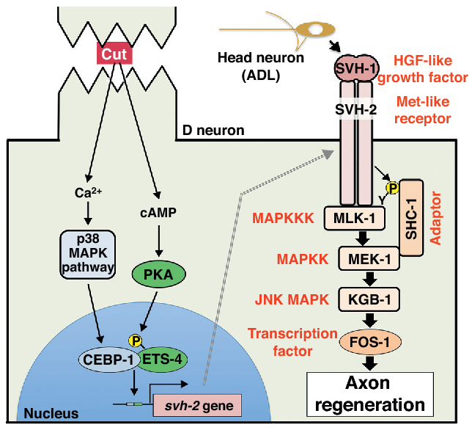

Slide 24
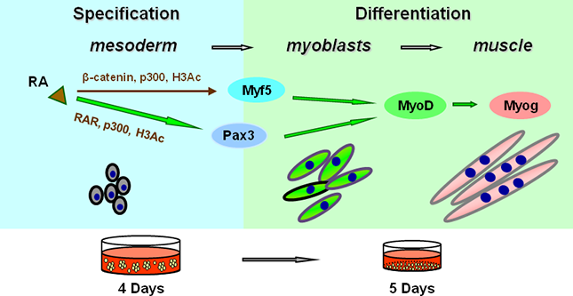
Muscle Regeneration
Retinoic Acid
Small molecules can induce stem cells to differentiate into a myoblastic lineage.
Embryonic stem cells treated with low-level doses of retinoic acid showed increased expression of the myoblastic markers (Pax3, Meox1 and myogenin) over control, which suggests the formation of myoblast progenitor cells (MPC), which ultimately differentiate into myoblasts.

Slide 25
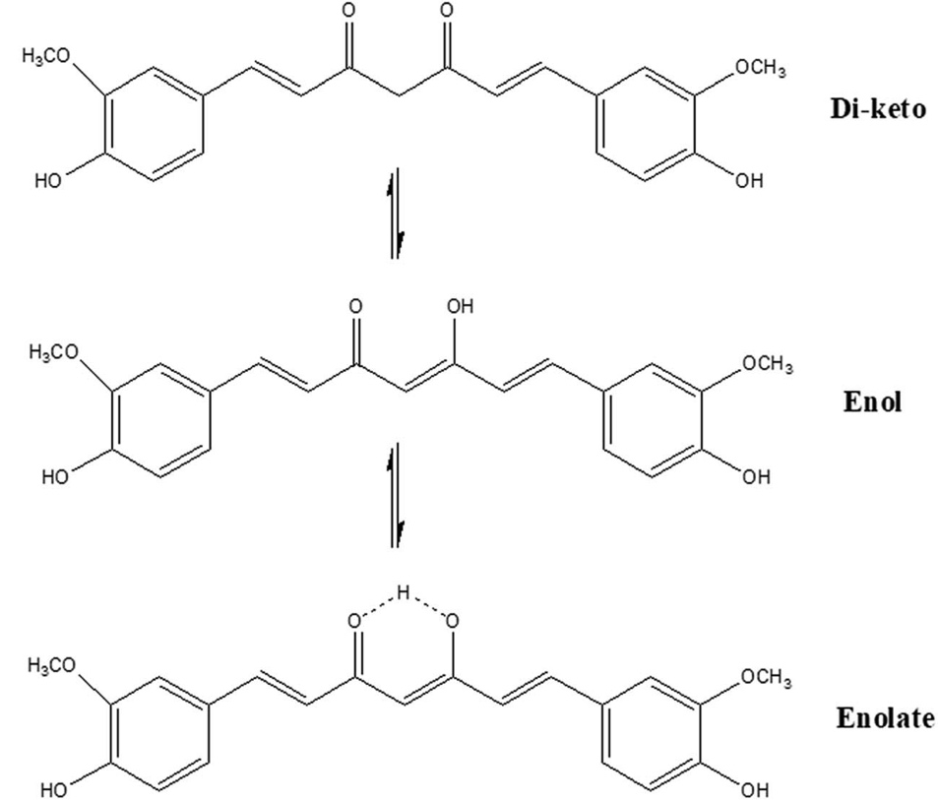
Curcumin
Angiogenesis
FGF
Extensive research on CUR has shown that the keto– enol–enolate form of the heptadienone moiety plays a crucial role in the anti-oxidant activities of curcumin.
In acidic and neutral conditions the bis-keto form acts as a potent proton donor while at pH > 8, the enolate form predominates and curcumin acts as an electron donor.
The presence of enolate in solution is found to be important in the radical-scavenging ability of curcumin.
Acidic environment is known to promote angiogenesis.

Slide 26
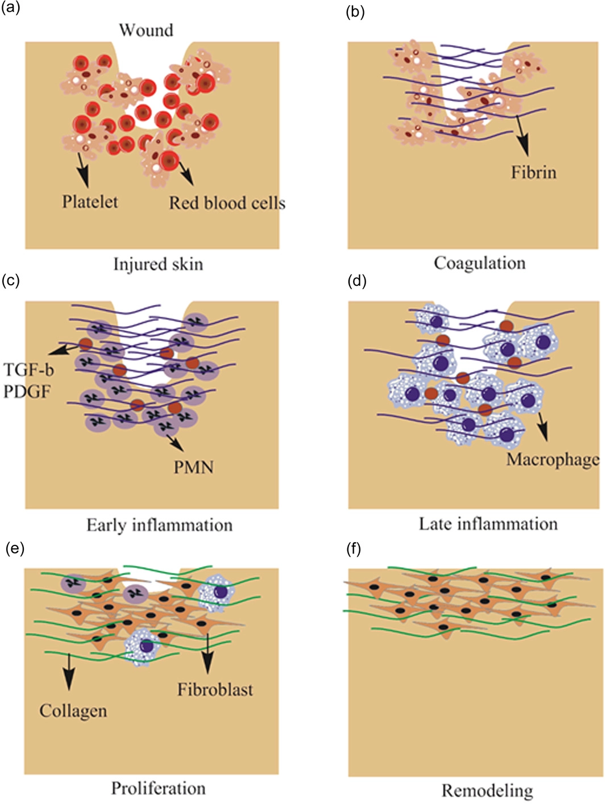
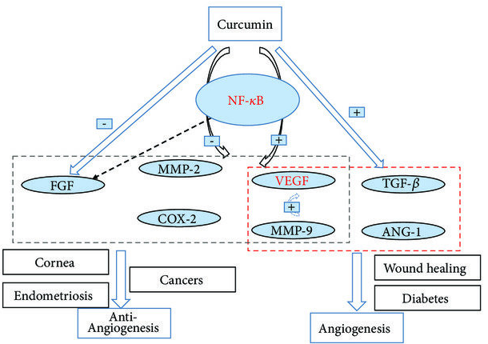
Curcumin enhances the expression of TGF-beta1 which improves angiogenesis.
Dextran hydrogel containing curcumin-loaded poly(lactide)/poly(ethylene glycol) nanomicelles applied to a dermal wound accelerated angiogenesis, fibroblast accumulation, and wound healing.

Slide 27

Thank you for your attention!

Slide 28
References
Govardhanagiri, S., Bethi, S., & Nagaraju, G. P. (2019). Small Molecules and Pancreatic Cancer Trials and Troubles. Breaking Tolerance to Pancreatic Cancer Unresponsiveness to Chemotherapy, 117–131.
Yi, B., Dissanayaka, W. L., & Zhang, C. (2020). Growth Factors and Small-molecule Compounds in Derivation of Endothelial Lineages from Dental Stem Cells. Journal of Endodontics, 46(9), S63–S70.
Goonoo, N., & Bhaw-Luximon, A. (2019). Mimicking growth factors: role of small molecule scaffold additives in promoting tissue regeneration and repair. RSC Advances, 9(32), 18124–18146.
Mitchell J and Lo KWH (2022), Small molecule-mediated regenerative engineering for craniofacial and dentoalveolar bone. Front. Bioeng. Biotechnol. 10:1003936.
Lo, K.W.-H. et al. (2014) “Small-molecule based musculoskeletal regenerative engineering,” Trends in Biotechnology, 32(2), pp. 74–81. Available at: https://doi.org/10.1016/j.tibtech.2013.12.002.
Aravamudhan A, Ramos DM, Nip J, Subramanian A, James R, Harmon MD, Yu X, Kumbar SG. (2013). Osteoinductive small molecules: growth factor alternatives for bone tissue engineering. Curr Pharm Des. 9(19), :3420-8.
Lanza, R.P. et al. (2020) Principles of Tissue Engineering. London: Academic Press, an imprint of Elsevier.
Marx, D. et al. (2020) “A review of the latest insights into the mechanism of action of strontium in Bone,” Bone Reports, 12, p. 100273. Available at: https://doi.org/10.1016/j.bonr.2020.100273.
Efe, J.A. and Ding, S. (2011) “The evolving biology of small molecules: Controlling cell fate and identity,” Philosophical Transactions of the Royal Society B: Biological Sciences, 366(1575), pp. 2208–2221. Available at: https://doi.org/10.1098/rstb.2011.0006.
Laurencin, C.T. et al. (2014) “Delivery of small molecules for Bone Regenerative Engineering: Preclinical Studies and potential clinical applications,” Drug Discovery Today, 19(6), pp. 794–800. Available at: https://doi.org/10.1016/j.drudis.2014.01.012.
https://www.fda.gov/

